Slide 1

AI Code Mentor: Instant Code Feedback
Discover AI Code Mentor, the web-based application designed for real-time syntax checking. It supports multiple languages and provides immediate feedback on code correctness.

Slide 2


Core Features
Multi-Language Support
Supports Python, C, C++, and Java.
Responsive UI
Accessible on all devices.
Instant Feedback
Real-time syntax error detection.
User-Friendly
Simple "paste and check" interface.

Slide 3





Technology Stack
Frontend
Backend
Communication
HTML, CSS, JavaScript.
Flask (Python).
HTTP POST requests.
Error Detection
Pylint, gcc.

Slide 4
User Interface Overview
Language Selection
Code Input
Submission
Feedback Display
Text area with syntax highlighting for easy coding.
"Check Code" button to submit the code for evaluation.
Area to show error messages and suggestions.
Dropdown menu to select Python, C, C++, or Java.

Slide 5
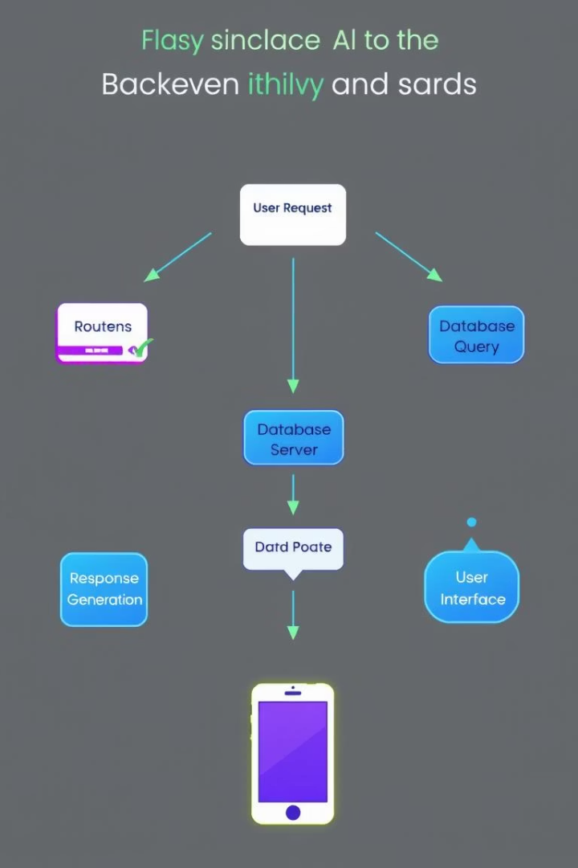




Backend Processing with Flask
Receive Request
POST request receives code and language.
Route Call
Flask route calls appropriate syntax checker.
Syntax Check
Specific steps for each language.
Return Messages
Error messages returned to the frontend.

Slide 6
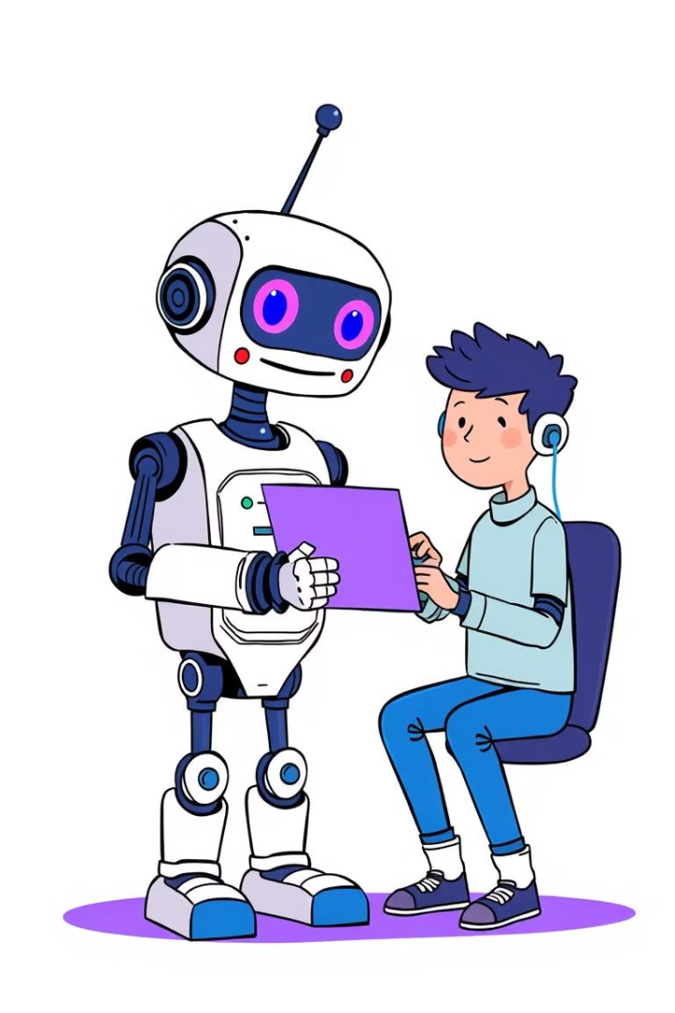
Benefits of AI Code Mentor
Time Saving
Multi-Language
Saves time debugging syntax errors.
Supports multiple programming languages.
Skill Improvement
Improves coding skills through instant feedback.

Slide 7

Live Demo
Code Submission
Submit code in each language.
Error Detection
Highlight real-time error detection.
Responsive Interface
Showcase the responsive user interface.

Slide 8

Try AI Code Mentor Today!
Web Application
Feedback
click here
Give us your feedback.
Collaboration
Coding
Contact us for collaboration.
Improve your coding now.

